Slide 1

SKU Grouping
Huang Wei

Slide 2

Problem Statement
Task: Based on the data given, group the same products together for future analysis
Generation of descriptive and concise group names
Include possible additional features
Evaluate grouping qualities
Challenges:
Unsupervised learning
The same product can be named differently by different sellers.
Text may contain either only one language or several languages.
Numbers in the title can be in both digit format and word format.

Slide 3
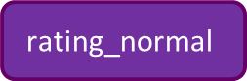
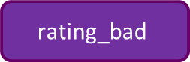


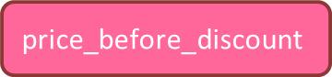
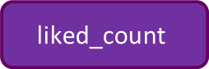
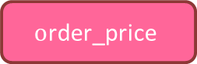
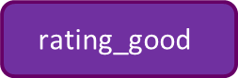
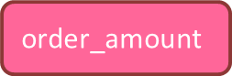

Summary of Grouping Process
Pre-grouping Categorization
Text Combination
item title
cat3 name
model
brand
cat1 name
Combined name
cat2 name
LDA clustering & Quality evaluation
K means clustering
$$\text{o}\text{rder}\text{_}\text{amount}$$
$$\text{rating}\text{_}\text{bad}$$
$$\text{rating}\text{_}\text{normal}$$
$$\text{rating}\text{_}\text{good}$$
$$\text{o}\text{rder}\text{_}\text{price}$$
$$\text{price}$$
$$\text{clicks}$$
$$\text{views}$$
$$\text{price}\text{_}\text{before}\text{_}\text{discount}$$
$$\text{liked}\text{_}\text{count}$$
Sales
Popularity
$$\text{total} \text{rating}=\text{rating}\text{_}\text{good}+\text{rating}\text{_}\text{normal}+\text{rating}\text{_}\text{ba}\text{d}$$

Slide 4
Summary of Variables
Baby / Home | BabyDescript / HomeDescript | BabySales/ HomeSales | BabyView/ HomeView | Shop
itemid | itemid | itemid | itemid | shopid
modelid | description | modelid | views | is_official_store
shopid |  | order_price | clicks | total_liked_num
item_name |  | order_amount | grass_date | rating_star
model_name |  | order_time |  | shop_rating_good
brand |  |  |  | shop_rating_normal
cat1_name |  |  |  | shop_rating_bad
cat2_name |  |  |  | shop_sold_total
cat3_name |  |  |  | shop_response_rate
price
rating_good
rating_normal
rating_bad
liked_count
price_before_discount
sold
image_count
cmt_count
ctime
Keys: itemid, modelid
Text based Clustering: item_name, model_name, brand, cat1_name, cat2_name, cat3_name
Sales clustering: order_price, order_amount, price_before_discount, price
Popularity clustering: liked_count, views, clicks, rating_good, rating_normal, rating_bad
Post Analysis: price
Unused Variables: shopid, sold, image_count, cmt_count, ctime, description, order_time, grass_date, is_official_store, total_liked_num, rating_star, shop_rating_good, shop_rating_normal, shop_rating_bad, shop_sold_total, shop_response_rate
Notes:
item descriptions not used:
More text than item names ➔ more computations to be done ➔ limited computer resource
Less concise and more possible noisy involved than item title
Shop information not used:
Different shops / sellers can sell the same products
Shop information is less closely related to item sales and popularity than item information

Slide 5

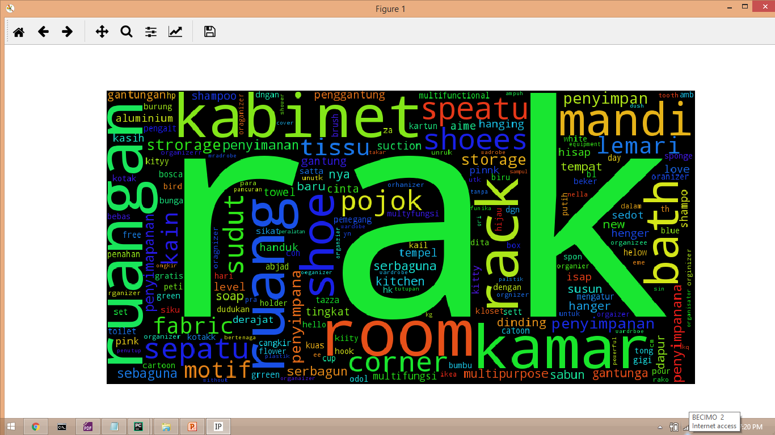
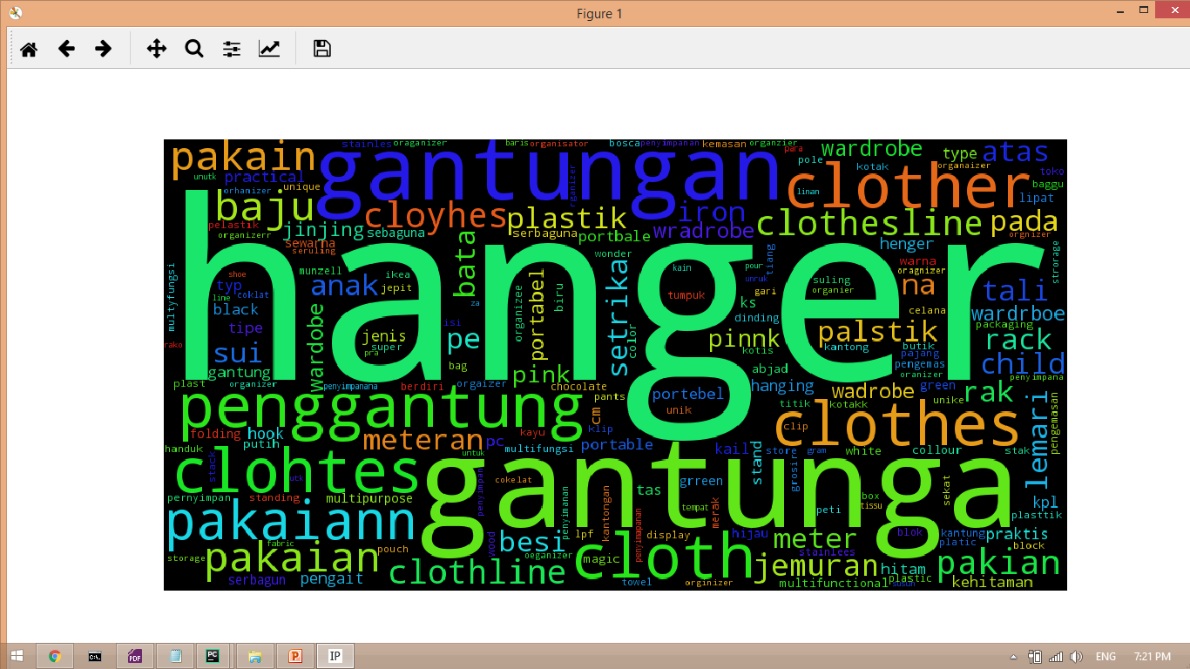
Part I: Text Based Clustering
Example:
Home_Storage_44
Home_Storage_75

Slide 6


Variables
Text Based Clustering
Non free text variables
Free text variables
cat1 name
description
Longer than title
Noisy
Possible missing and incomplete values
cat2 name
item title
cat3 name
model
brand
Pre-Clustering Categorization
Combined name 1
Text Based Clustering
Notes:
Shopee is currently a C2C + B2C marketplace
Different sellers may name the same product differently
Item title
most information is concentrated in title, more concise than item description
no missing values
shorter, so less calculation needed: more efficient
Free text variables suffer from missingness and information overlapping

Slide 7
Pre-processing
Text Based Clustering
Free text variables
item title
cat3 name
model
brand
Remove strange names (NaN, ‘others’, ‘0’, …)
Remove punctuations (Exception: keep ‘&’ in brand)
Combined name 1
Lower case
Add space between numbers and letters
Combined name 2
Notes:
ampersand

Slide 8
Pre-processing
Text Based Clustering
English Stop words (‘cheap’, ‘sales’, ‘affordable’, …)
googletrans
Translation extended Stop words (en, ms, tl, id)
Remove Stop Words
Combined name 2
Combined name 3
word2num
Change number from text format to digit format
Combined name 4
Eg. One ➔ 1
Notes:
Check how many missing value are in description
Item title
most information is concentrated in title, more concise than item description
no missing values
shorter, so less calculation needed: more efficient
Free text variables suffer from missingness and overlapping

Slide 9
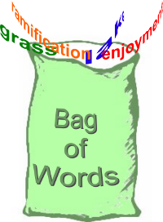
Pre-processing
Text Based Clustering
Short and Concise
Adjectives and nouns
Many languages !
Combined name 4
Unigram
Tokenization
googletrans
Number tokens
Non number tokens
Less time used!
Dictionary

Slide 10
Pre-processing
Text Based Clustering
All Tokens
Unigram
Number tokens
Non number tokens
Grouping semantically equivalent tokens
Token Groups
Dictionary
Notes:
Check how many missing value are in description
Item title
most information is concentrated in title, more concise than item description
no missing values
shorter, so less calculation needed: more efficient
Free text variables suffer from missingness and overlapping

Slide 11
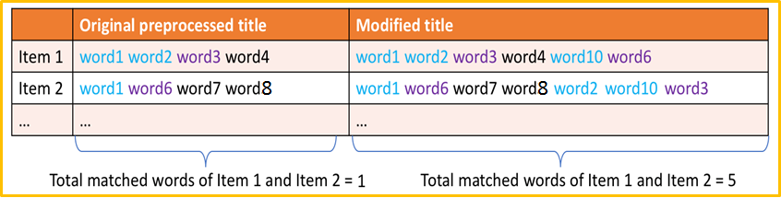
Pre-processing
Text Based Clustering
Combined name 4
Token Groups
Translation Modified Combined name
Notes:
Check how many missing value are in description
Item title
most information is concentrated in title, more concise than item description
no missing values
shorter, so less calculation needed: more efficient
Free text variables suffer from missingness and overlapping

Slide 12
Clustering
Text Based Clustering
Latent Dirichlet Allocation
A popular topic modelling technique
Assumptions:
Documents cover only a small set of topics and topics use only a small set of words frequently
Number of topics is known
Each topic has the same length
Advantages:
Acceptable computational complexity (T topics and n tokens in the corpus: T ^{n})
Generates probabilities for both topics and tokens
Soft clustering
Limitations:
Fixed number of topics
Non-hierarchical
Cannot capture correlations of topics
No objective metric (perplexity can be a poor indicators of cluster quality)
Short text may affect the topic distribution inference
→ Not really but similar
Flexible & Interpretable
→ Not too bad if only the highest probability is chosen
Notes:
The advantages of LDA over LSI, is that LDA is a probabilistic model with interpretable topics. The disadvantages are that it is hard to know when LDA is working --- topics are soft-clusters so there is no objective metric to say "this is the best choice" of hyperparameters. Metrics like perplexity (how well the model explains the data) are okay to test if the learning is working, but very poor indicators of the overall quality of the model. For example, you could have a model with very low perplexity, but whose topics are not very informative.

Slide 13
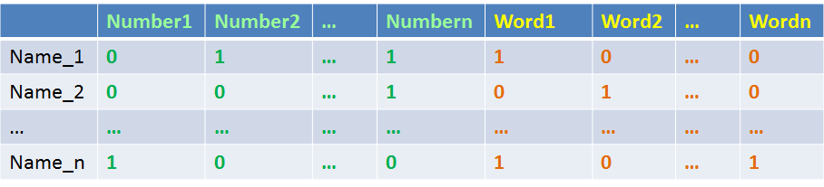
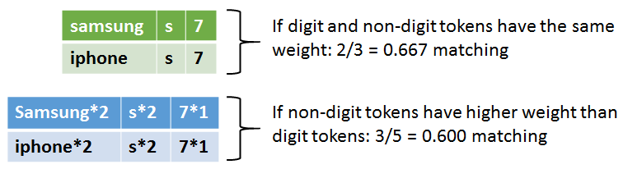
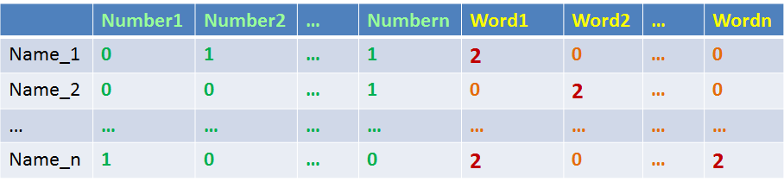
Clustering
Text Based Clustering
Binary Frequency
Weighted
Binary Frequency

Slide 14
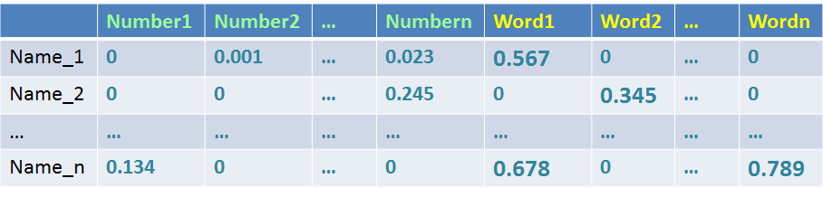
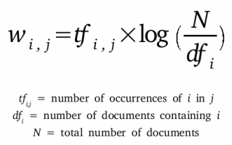
Clustering
Text Based Clustering
Term Frequency – Inverse Document Frequency
Weighted
Binary Frequency

Slide 15
Clustering
Text Based Clustering
Number of topics to choose
Category A
Category B
cat1 name
cat2 name
…
n1 items
n2 items
…
Variable to adjust:
Average number of items per topic: X
Number of topics:
T = n/X
Value of X tried:
500 and 1000
T1 topics
T2 topics
…

Slide 16
Clustering
Text Based Clustering
Latent Dirichlet Allocation
 | Topic_1 | Topic_2 | … | Topic_j
Title_1 | Topic_Prob_11 | Topic_Prob_12 | … | Topic_Prob_1j
Title_2 | Topic_Prob_21 | Topic_Prob_22 | … | Topic_Prob_2j
… | … | … | … | …
Title_i | Topic_Prob_i1 | Topic_Prob_i2 | … | Topic_Prob_ij
For Title_i, the corresponding topic of the maximum probability is set as Title_i’s group number
For each topic, find the corresponding titles of top 10 highest probability ➔ use the average number of tokens in these titles as the number of words to chose for the topic title
Tokens | Token Probability
Token_1st | Prob_1st
Token_2nd | Prob_2nd
… | …
Token_nth | Prob_nth
Titles | Topic_i probability | Number of tokens in the title
Title_1st | Topic_Prob_1st | N1
Title_2nd | Topic_Prob_2nd | N2
… | … | …
Title_10th | Topic_Prob_10th | N10
Top N highest
probabilities
Top 10 highest
probabilities
Number of tokens for the topic title:
N = Average of N1 : N10
Topic_i title =
Token_1st, Token_2nd, …, Token_nth
Notes:
Check how many missing value are in description
Item title
most information is concentrated in title, more concise than item description
no missing values
shorter, so less calculation needed: more efficient
Free text variables suffer from missingness and overlapping

Slide 17
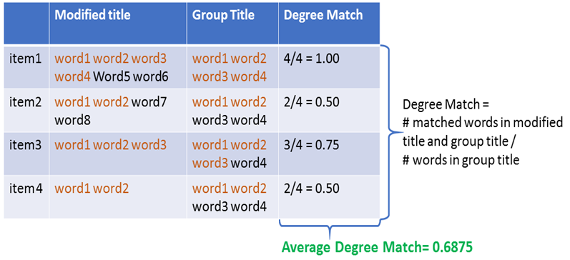
Clustering
Text Based Clustering
LDA cluster quality evaluation
1. Average Percentage Title Matching
How well each group title represents the group
Group Title vs. Translation Modified Item Title
Notes:
Check how many missing value are in description
Item title
most information is concentrated in title, more concise than item description
no missing values
shorter, so less calculation needed: more efficient
Free text variables suffer from missingness and overlapping

Slide 18
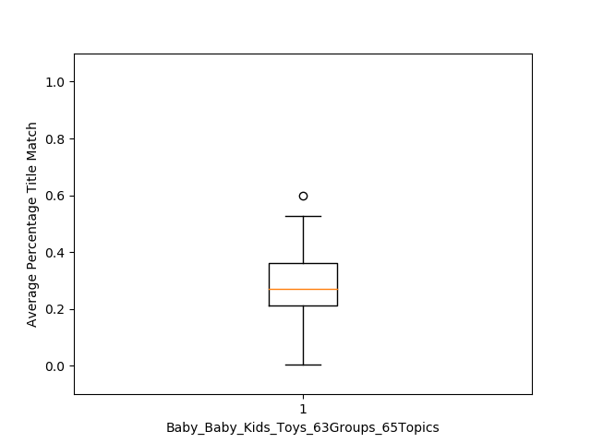
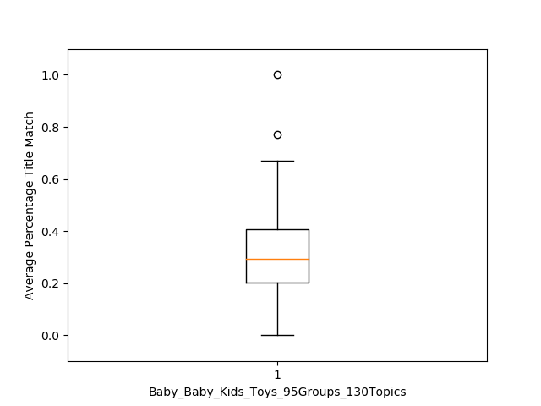
Clustering
Text Based Clustering
LDA cluster quality evaluation
1. Average Percentage Title Matching
Example:
Average number of items per topic
500
1000
Min = 0.003
Mean = 0.286
Max = 0.598
Min = 0.000
Mean = 0.316
Max = 1.000
Notes:
Choice of grouping is based on this method
;

Slide 19
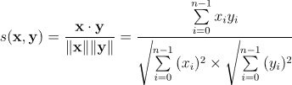
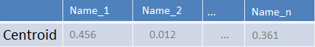
Clustering
Text Based Clustering
LDA cluster quality evaluation
2. Within Cluster Average Title Distance
Weighted
Binary Frequency
Average
Cosine Distance
Average Title Distance

Slide 20
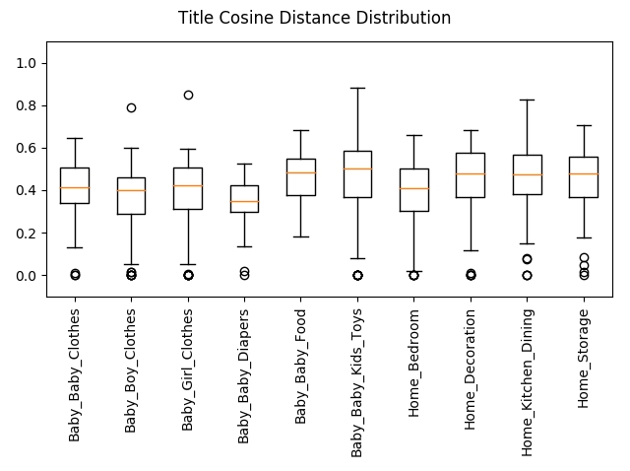
Clustering
Text Based Clustering
LDA cluster quality evaluation
2. Within Cluster Average Title Distance
Threshold needed to decide the groups which should be further separated
Small sized groups
Notes:
Check how many missing value are in description
Item title
most information is concentrated in title, more concise than item description
no missing values
shorter, so less calculation needed: more efficient
Free text variables suffer from missingness and overlapping

Slide 21
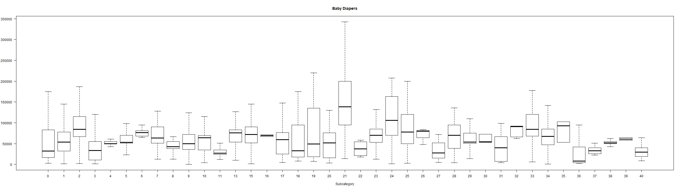
Clustering
Text Based Clustering
LDA cluster quality evaluation
3. Price Distribution and Outlier Detection
Example:
Box-plot of all Baby Diapers groups
Small box with almost no outliers → good quality
Big box with extreme outliers
→ further investigation via sampling
→ further grouping
548
2713
2602
906
105
1348
49
48
37
894
79
58
2399
354
2
169
13
12
165
231
4
349
407
175
3
20
69
2092
6
28
5
85
3758
6
95
34
701
2
89
Number of Items
Notes:
Check how many missing value are in description
Item title
most information is concentrated in title, more concise than item description
no missing values
shorter, so less calculation needed: more efficient
Free text variables suffer from missingness and overlapping

Slide 22
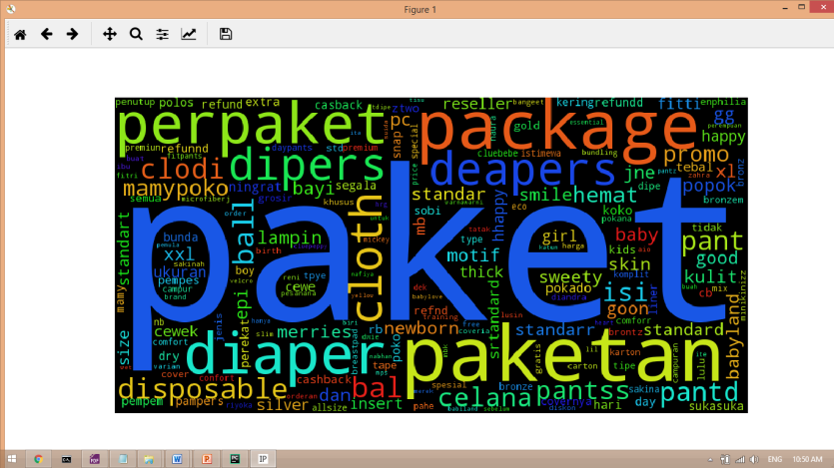
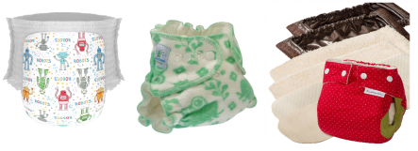
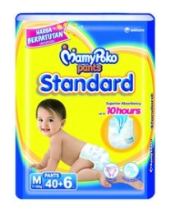
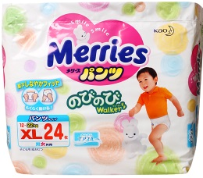
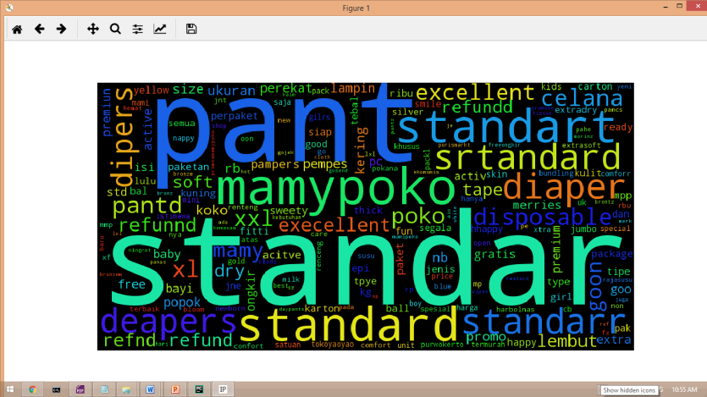
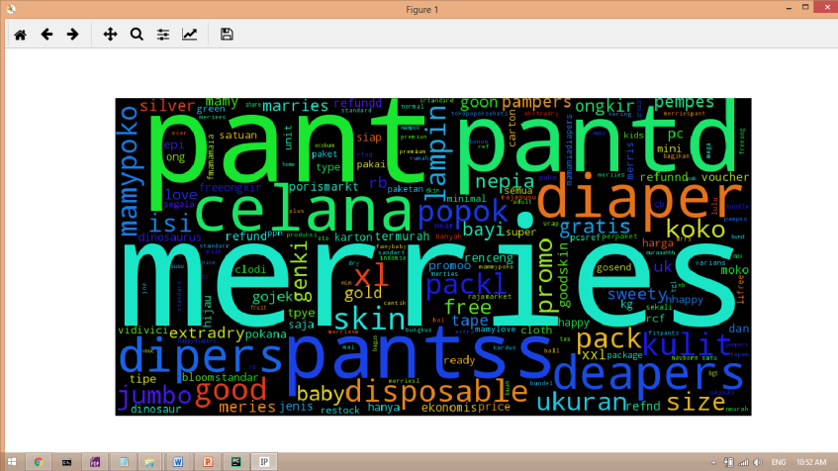

Clustering
Text Based Clustering
LDA cluster quality evaluation
4. Word Cloud
Example:
Brand? Type?
548
2713
2602
906
105
1348
49
48
37
894
79
58
2399
354
2
169
13
12
165
231
4
349
407
175
3
20
69
2092
6
28
5
85
3758
6
95
34
701
2
89
Number of Items
Notes:
Check how many missing value are in description
Item title
most information is concentrated in title, more concise than item description
no missing values
shorter, so less calculation needed: more efficient
Free text variables suffer from missingness and overlapping

Slide 23
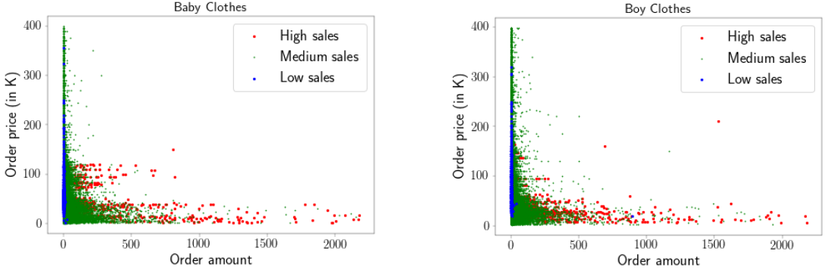
Part II: Numerical Data Based Clustering
Example:

Slide 24
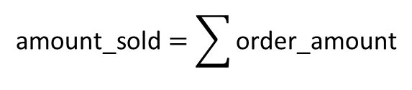

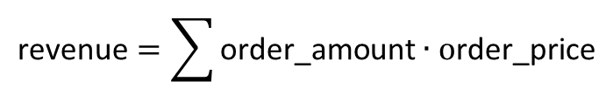
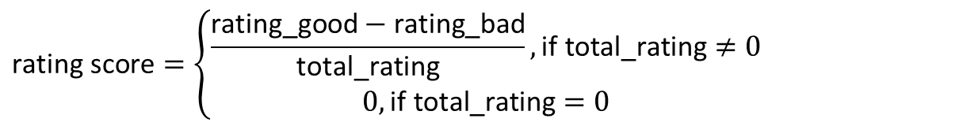
Pre-processing
Numerical Data Based Clustering
Sales
$$\text{amount}\text{_}\text{sold}=\sum{\text{o}\text{rder}\text{_}\text{amount}}$$
$$\text{r}\text{evenue}=\sum{\text{o}\text{rder}\text{_}\text{amount}∙\text{o}\text{rder}\text{_}\text{price}}$$
$$\text{discount} =\left\{\begin{aligned}\text{price}\text{_}\text{before}\text{_}\text{discount}−\text{price}\text{, }\text{if} \text{price}\text{_}\text{before}\text{_}\text{discount}≠0 \\ 0, \text{if} \text{price}\text{_}\text{before}\text{_}\text{discount}=0\end{aligned}\right.$$
Popularity
liked_count
Scaled
views
$$\text{clicks}$$
$$\text{total}\text{_}\text{rating}=\text{rating}\text{_}\text{good}+\text{rating}\text{_}\text{normal}+\text{rating}\text{_}\text{ba}\text{d}$$
$$\text{rating} \text{score}=\left\{\begin{aligned}\frac{\text{rating}\text{_}\text{good}−\text{rating}\text{_}\text{bad}}{\text{total}\text{_}\text{rating}},\text{if} \text{total}\text{_}\text{rating}≠0 \\ 0,\text{if} \text{total}\text{_}\text{rating}=0\end{aligned}\right.$$

Slide 25
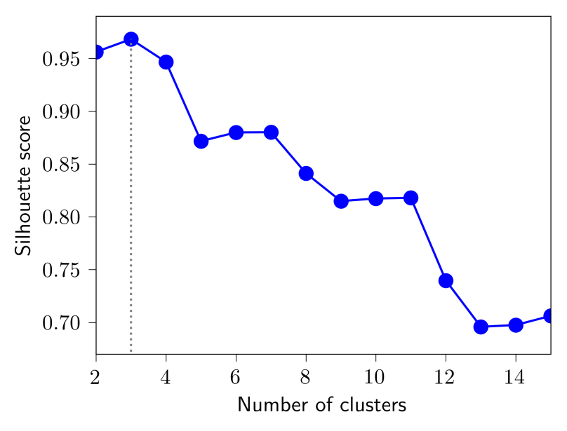
Clustering
Numerical Data Based Clustering
K-means clustering
Choose K
Example: Baby_Boy_Clothes_78Groups_184Topics:
Maximum value (0.968) is achieved for 3 clusters
K =3 is optimum for most groups
All groups are clustered with K=3 for consistency

Slide 26
Result Interpretation
Numerical Data Based Clustering
K-means clustering
Example: Baby_Boy_Clothes
Sales
Baby_Boy_Clothes | Averages
Category | amount_sold | revenue | discount
High sales | 893 | 25726669 | 800
Medium sales | 22 | 832404 | 839
Low sales | 5 | 350913 | 81646
Popularity
Baby_Boy_Clothes | Averages
Category | views | clicks | liked_count | total_rating | rating_score
High popularity | 353908 | 281465 | 100632 | 27948 | 0.967
Medium popularity | 34271 | 29634 | 19390 | 11641 | 0.937
Low popularity | 778 | 629 | 250 | 183 | 0.840

Slide 27
Possible Improvement
Current work | Future work
English number words are converted to digit before translation mapping. | Numbers in digit form can be mapped to numbers in English word form after mapping the translation of different languages. In this way, the number words in all languages can be matched and converted to digit.
Only unigram was used. | Bigram and trigram can be tried.
Item description not used. | Item description can also be analysed.
Only text and numeric data was used. | Additionally, image analysis can greatly improve grouping quality.
Latent Dirichlet Allocation (LDA) was used for grouping selected text data. | Hierarchical Dirichlet Allocation (HDA) for grouping text data.
Only one pass LDA is applied to selected text data. | Further separation for low quality group.
Average items per topic tried are 1000 and 500. | Average items per topic can be adjusted to obtain better grouping quality.
Token redundancy in frequency matrix caused by semantically equivalent token mapping leads to extra calculations in LDA. | Imaginary tokens can be created to represent groups of semantically equivalent tokens.
Text based grouping based on LDA results only. | Price can be added on top of text based grouping to improve the quality.
No misspelling was handled. | Study misspelling correction.
No semantic similarity of words calculated. | Try Python package ‘sematch’.

Slide 28
Q & A
Thanks!

